Slide 1

PSU DIAGRAM
Aijahnae , Christina , Auree-Lynn , Charles , Yasmeen

Slide 2
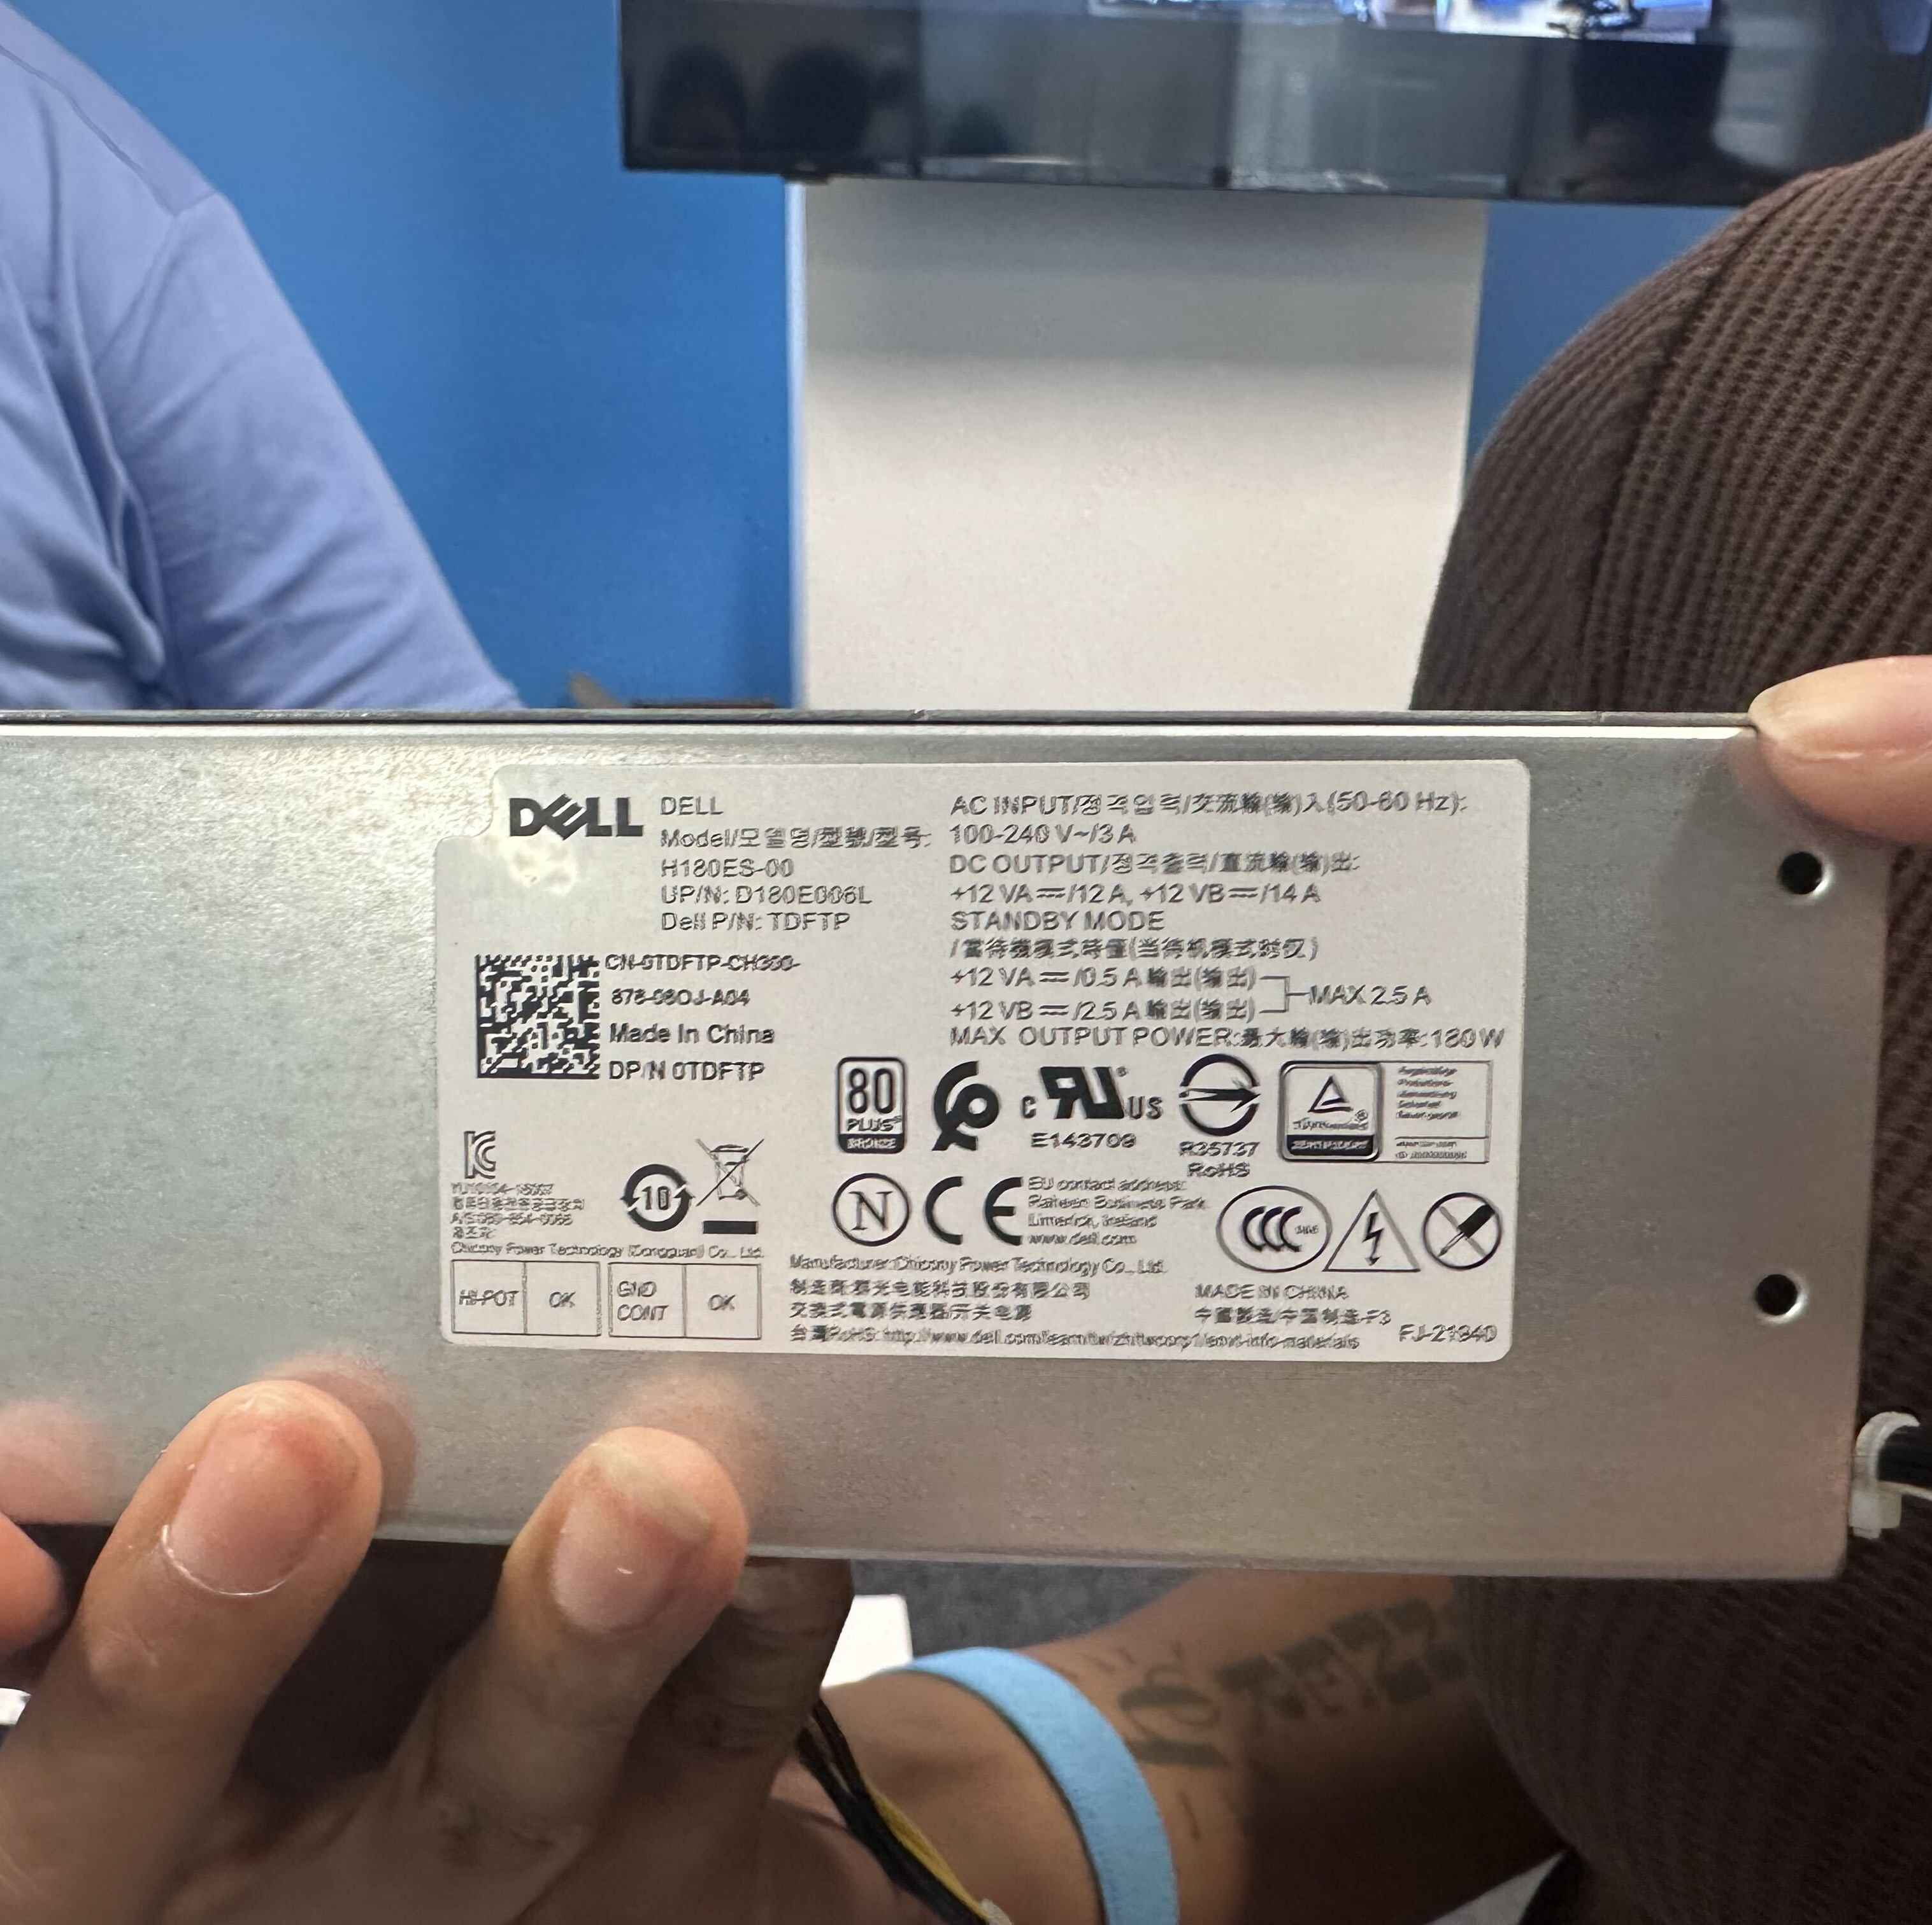
PSU Battery Info.
Model – Dell
AC Input - (50-60Hz) , 100-240 V
DC Output - +12V
Max Output Power – 180W

Slide 3
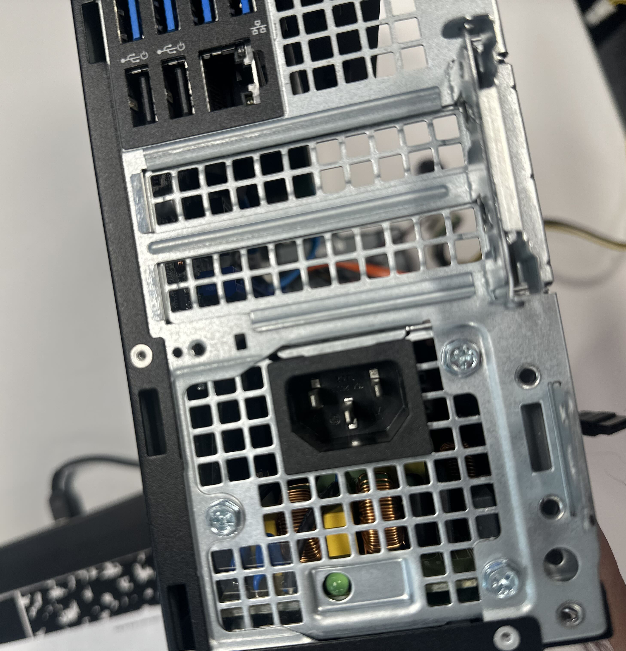
Back Panel of the PSU
This is the back panel of a small form factor (SFF) desktop computer chassis, specifically showing the rear I/O and power supply area (commonly found on business desktops like a Dell OptiPlex).
Power Supply Unit (PSU) Inlet: The 3-pin C14 connector at the bottom (oriented horizontally/upside down here) where you plug in a standard AC power cord. Next to it is a small green LED diagnostic indicator light.
Rear I/O Ports: Above the expansion slots, you can see USB ports (USB 3.0 blue ports, USB 2.0 black ports) and an RJ-45 Ethernet network port.
PCIe Expansion Slot Covers: The mesh metal covers in the middle section protect expansion slot openings for adding low-profile expansion cards (like extra graphics or network cards).

Slide 4
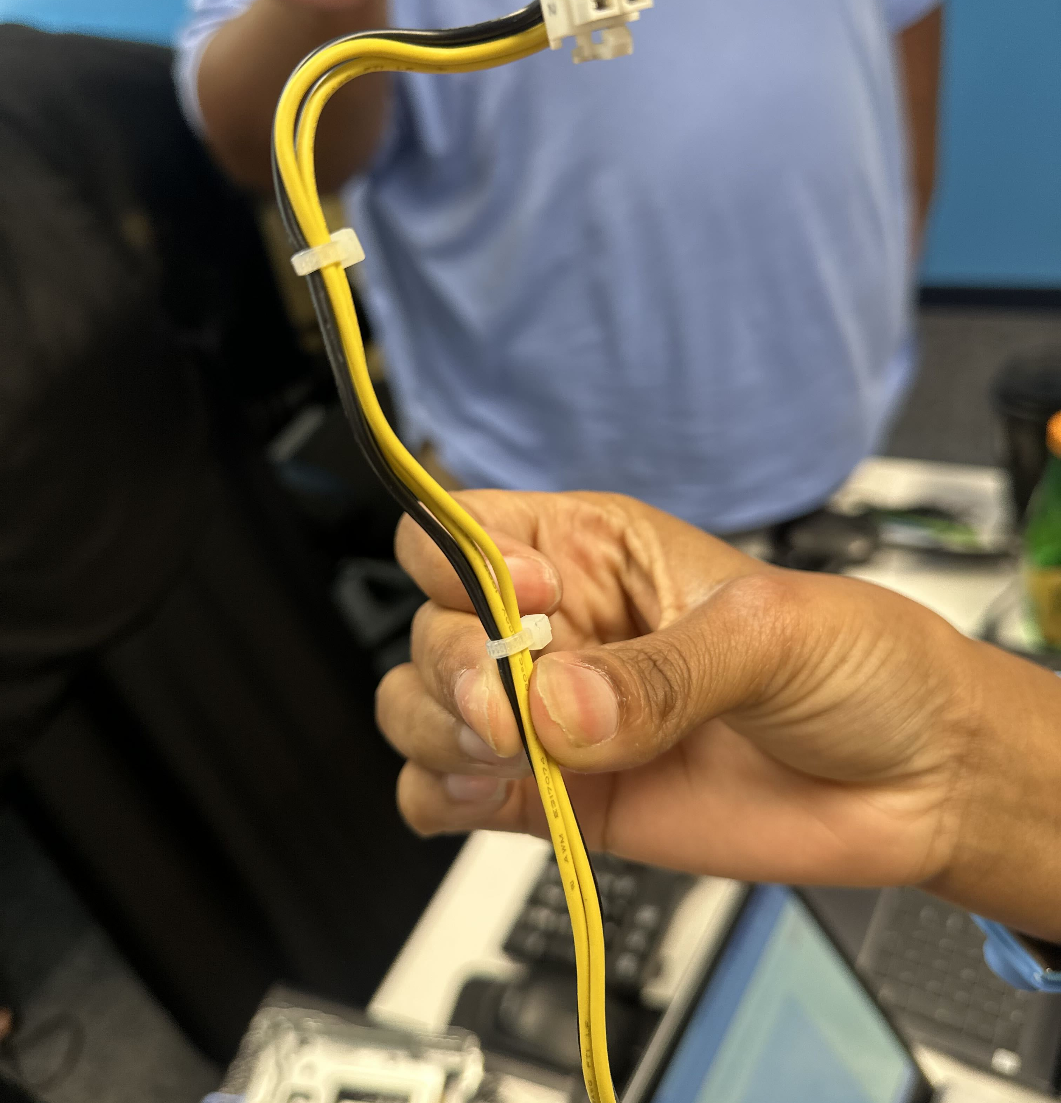
CPU Power Connector.
1. 4-Pin CPU Power Connector (Held in Hand) • Technical Name: 4-Pin ATX12V Power Connector (or 4-Pin CPU Power Connector) • Wiring Breakdown: Yellow Wires: +12V DC power Black Wires: Ground (GND) • Function: Delivers dedicated +12-volt direct current power directly to the processor (CPU) socket on the motherboard through a VRM (Voltage Regulator Module). • Key Feature: Plastic locking tab on the side prevents accidental disconnects and ensures correct orientation during installation.

Slide 5
